Slide 1


International Service Projects
RLI - Part III
Notes:
Begin the session:
Introduce self
Describe format for the session
Talk about what materials are available and/or where they can be found

Slide 2
Goals:
Discuss
Discuss what International Service means
Investigate
Investigate how individual Rotarians can contribute to International Service
Exchange
Exchange ideas about why local clubs should be involved in International Service
Explore
Explore ideas for International Service Projects
Notes:
Review session goals and where this course fits into the Service curriculum of RLI.
Point out referenced materials and where they can be found
Direct participants to the disclaimer “consult your district for specific Rotary Foundation training and information”
Point out inserts for International Service:
International Service
Insert IS-1: Suggested Steps in Developing a World Community Service Project
Insert IS-2: Scenarios for International Service Projects
Insert IS-3: Sample Matching Grant Budget
Insert IS-4: What is World Community Service?

Slide 3
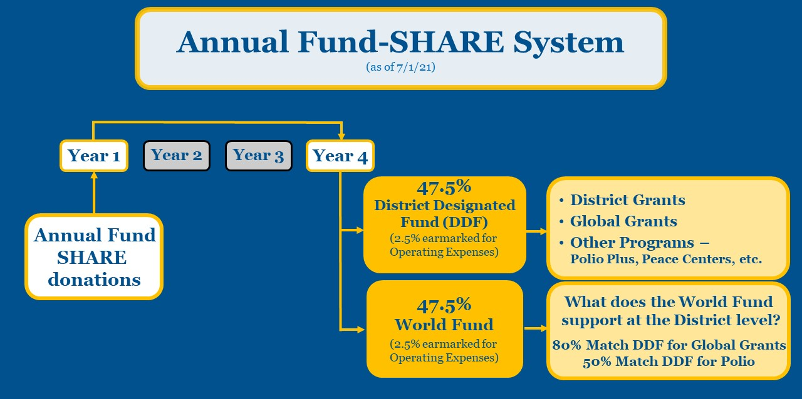
Grant Funding Model
Notes:
Review the Grant Model from Part 2: Targeted Service
Share The Rotary Foundation Guide to Global Grants (1000_guide_to_global_grants_en.pdf)
The Grant Model is a powerful tool for mobilizing Rotarians for service in communities around the world, and it is financed by SHARE program which keeps much decision-making local and helps fund the global and collective priorities of Rotary and The Rotary Foundation*
*Grant Model updated July 1, 2020 – Be sure to use updated model

Slide 4
Together, we see a world where people unite and take action to create lasting change across the globe, in our communities, and in ourselves.
Vision Statement
International Service – How does it fit?
Notes:
Share the Vision Statement of Rotary
Use your “virtual hand” to offer examples from your club of international service that address vision statement.
Encourage participants to offer their thoughts on this question

Slide 5
What does International Service mean?
Expand your knowledge and club's capacity
Service Engagement
Notes:
Offer the following information about International Service as desired beginning with the question:
What is International Service (from a Rotary perspective)?
Connections between Rotarians or clubs from different countries present opportunities for International Service
Fellowship activities; Twin-club exchanges; “Make-ups” while on vacation internationally, meeting others at RI International Conventions; non-Rotary Foundations supported activities of Rotarians
Catalyst for service since we are all part of Rotary and want to promote world peace, goodwill and understanding one relationship at a time
Rotary Foundation sponsored grants, exchanges and scholarships are a small, but important, subset of possible international service opportunities
No Rotary Foundation approval or “permission” is required to do most of the International Service
It is a Rotarian-to-Rotarian or Club-to-Club activity

Slide 6
What is the Goal of
INTERNATIONAL SERVICE?
Notes:
Talk to the group about the GOAL of International Service. Use the BLANK SLIDE to collect responses.
What is the GOAL of International Service?
Acknowledge responses as they are posted

Slide 7
Why do I care?
Object of Rotary
  Fourth – the advancement of international understanding, goodwill, and peace…
  Service Awards
    Examples of Activities that merit
  Local vs. International
Notes:
Talk about the GOAL of International Service.
Include some of the following into the discussion:
From the Object of Rotary
FOURTH – The advancement of international understanding, goodwill, and peace through a world fellowship of business and professional persons united in the ideals of service
Why shouldn’t we just concentrate on our local communities
Our world seems to get smaller and more interconnected every day
All International Service IS local to one of the participating Rotary clubs

Slide 8

BREAKOUT
Serving Internationally
“While traveling internationally a Rotarian visited a Rotary club and became interested in helping with a problem in that community.”
How to proceed?
Notes:
Introduce the next activity of planning an International Project.
We will now break into groups. Here is the situation:
A Rotarian while traveling internationally visited a Rotary club and became interested in helping with a problem in that community. After obtaining her club’s commitment to do something, how should they proceed? Choose a spokesperson and recorder. Using the Insert IS-2, come up with a project idea and sketch out a preliminary plan. You have 10 minutes to discuss. Then we will come back together and talk about what you have.
Divide participants into small groups of about three (3) each.
After 10 minutes have passed bring the group back together.
Invite each group to share their thoughts.
WEB ASSIGNMENT – (For two-day events)
Introduce Global Grants Foundation Guide to Global Grants as resource. (https://my.rotary.org/en/take-action/apply-grants/global-grants).
Direct participants to access the website between now and tomorrow morning. At that time, we can hear what you discovered.

Slide 9
International Service Global Grant
FIVE TIPS
Successful Global Grant Application
Conduct a Community Assessment
Avoid common mistake – Project must fall within Area of Focus
Look out for ineligible expenses
Check out Rotary Showcase for a project partner*
Seek out local District International Service Chair during the application process.
*https://map.rotary.org/en/project/pages/project_showcase.aspx
Notes:
Is anyone interested in applying for a Global Grant. Review the tips for successful global grant application.
Talk about where to find resources to help in global grants

Slide 10

International Service Project
Cause Related
Notes:
Review the Seven Areas of Focus
Point out how and why these focus areas are of importance in Rotary International Service.
Discuss how the Areas of Focus are used in Global Grants

Slide 11


With or Without THE ROTARY FOUNDATION?
WITHOUT – lack of bureaucracy; reporting easier; smaller scale
WITH – multi-country; structure; accountability
Notes:
Highlight common themes or other insights from the debrief, including but not limited to:
There is no one way to approach project design
Thoughtfully approaching the process and problem in advance and throughout is important
Flexibility and reassessment is key
Experts are everywhere and just need to be asked
Experience is important and should be sought out in participants or partners.
Don’t reinvent the wheel, unless it is a better wheel
Despite how complex the project is, keep in mind the “heart” of the project, the people in the community being helped.
Brainstorm the advantages of International Service with and without The Rotary Foundation involvement.
Without TRF many activities are easier because of lack of bureaucracy, reporting, and scale of the project
TRF involvement lends structure, expertise, and accountability which are all important in multi-country interactions.
TRF SHARE Funding Model* can multiply and leverage available funds, however…
There can be unwanted restrictions on use of funds

Slide 12
International Connections?
International Students
Rotary Fellowships
Community Core Group
Peace Fellows
Habitat For Humanity
Notes:
Form groups with 3-4 participants / group.
Breakout groups will explore International Service that does not involve doing a service project.
Using Inserts IS-3: RI Programs – Service Opportunities and IS-4: Get Connected – Network Internationally we will revisit the same situation posed earlier only this time explore activities that do not include service projects:
“A Rotarian while traveling internationally visited a Rotary club and became interested in helping with a problem in that community. After obtaining her club’s commitment to do something, how should they proceed”?
Determine what type of “problem” might be encountered internationally that can be addressed with one of Rotary’s programs and/or service opportunities. Decide what the problem might be and offer a recommendation to address it.
Begin breakouts
Reconvene the whole group and have each group share their ideas.
Encourage feedback from the rest of the group
Review the International Connections depicted on the slide:
International Students – attending Universities/ESL Community Colleges
Rotary Fellowships – vocational; recreational; service
Community Core Groups – not Rotarians but community members that want to improve their community.
Peace Fellows – college graduate looking to expand international expertise
Habitat for Humanity (partners)
Other?

Slide 13
Rotary Districts an International Resource
Multi-club Grants and Projects
Tie project into visiting international visitors like VTT
Friend-ship Ex-changes
DGs promote on club visits
DG, AG, DRFCC, TRF websites
Notes:
Rotary Districts are a unique International Resource.
How can YOUR Rotary District be a resource for International Service?
Give participants an opportunity to share ideas from their home district. Add some of the following as time and opportunity allows:
Promote multi-club grants and projects
Highlight needs and people in need at district events
Tie project into visiting international visitors, especially VTT (Vocational Training Teams)
Rotary Volunteers and Friendship Exchanges
Governors can discuss on club visits.
Resources include – DG, AG, DRFCC, TRF Websites

Slide 14


Vocational Skills and International Service
Using personal expertise in volunteering on a project
Join a Rotary Action Group that makes use of specific skills and talent
Fourth Object of Rotary – advancement of international understanding, goodwill and peace through a world fellowship of business and professional persons united in the ideal of service.
Notes:
Vocational skills can be key in providing service internationally.
What ideas do you have regarding using vocational skills internationally?
Some might include:
Volunteering to work on a project within you area of expertise
Volunteering with a Rotarian Action Group that makes use of your skills or talents.
How can an International Service activity fulfill your commitment to the Object of Rotary?
From the Object of Rotary – FOURTH: The advancement of international understanding, goodwill, and peace through a world fellowship of business and professional persons united in the ideal of service.
Each Rotarian must determine what that means to them personally and where it fits into their life
Their association with Rotary gives them unparalleled access to a worldwide organization of like-minded “do-gooders”.
How can you “turn on” other Rotarians in your club to the excitement and reward of International Service?
Create an International Committee and explore the possibilities of the club doing an international project
Consider participating in a Rotary Action Group, a fellowship or another Program of RI (https://www.rotary.org/en/our-programs )
Join other clubs in their international efforts

Slide 15
Summary
Part 1:TRF – Doing Good in the World
Part 2: Grant Model – How to Do Good in the World
Part 3: International Service – Roadmap to working Globally
Thank You!
Notes:
Summarize referring back to the sessions in Parts 1 and 2 dealing with the Foundation:
In Part I, we were inspired by the good our foundation is doing in the world
In Part II, we explored some of the “how” of “doing good in the world”, with terminology, tools, key concepts, and methods of the Grant Model.
In this session, Part III, our goal is to provide you with a ‘roadmap’ to International Service, including getting involved and getting others involved in ‘doing good in the world’
Your thoughtful approach to a need, use of your skills, and your commitment to helping others will get you a long way toward participating in International Service
All projects are local to somebody. The needs are local and real. A small project you start or in which you participate today could develop into the next big project.
As Rotarians we have adopted a mission to help others. Now knowing some of what is available through our foundation, use these tools, motivate your club, go to your district seminars, develop your Rotary contacts and start “doing good in the world”.
In a world filled with bad news of poverty, crime, and misfortune, we are a force for good in the world. We are making a difference. You are making a difference.

