Slide 1


Effective Leadership Strategies
RLI - Part 3
Notes:
Begin the session:
Introduce self
Describe format for the session
Talk about what materials are available and/or where they can be found

Slide 2
Goals:
Analyze
Analyze ways to win support for new initiatives
Review
Review Possible Options in Leading and Communication with Groups
Discuss
Discuss Ways in which to Build Coalitions
Understand
Understand the Importance of Influence in Leadership
Notes:
Review Session Goals, where this course fits into the Leadership curriculum of RLI
Quickly review Insert: ELS-1 “Good to Know for Effective Leadership Strategies”

Slide 3
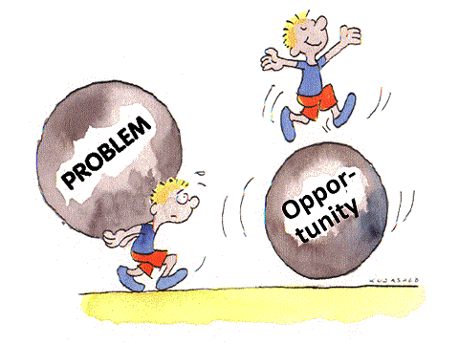
Notes:
Share this cartoon
Ask participants to share in one or two words what comes to mind when looking at the cartoon.
What first comes to mind when you look at this image?
Direct the group to unmute and use your VIRTUAL HAND to respond.
Take three or four examples to control the time spent on this slide.

Slide 4
Edward F. Cadman
1985-1986 RI President
“One of the marvelous assets of Rotary is that such a vigorous and viable organization can grow in strength each year as new leadership develops.”
Notes:
Share this quote from RI President Edward Cadman. Bridge the backbone of leadership to the success of Rotary.
What does the word “EFFECTIVE” mean?
Repeat with LEADER and STRATEGY
Take two or three ideas for each – again have them use VIRTUAL HANDS to respond
In this context “Effective” describes our “Leadership Strategy”. The dictionary says it means producing the intended or expected result. All Rotarians are all LEADERS. A key attribute for the purpose of Rotary is “influence”. The dictionary says that STRATEGY is a ‘plan for obtaining a specific goal or result’. We explored Strategic Planning in Part 2.

Slide 5
Arts & Crafts Show
1. Big Project/Small Club
Announce
Announce plan at club meeting
Seek out
Seek out influential member as your champion
Talk
Talk to the club board
Consult
Consult with the president and key officers
Develop
Develop a plan to present
Notes:
Refer to Insert ELS-2: Effective Leadership Strategies – Scenario 1
Read the situation to the group
How do you determine your first step?
In seeking approval for having an Arts and Crafts Show in the community. In developing your strategy what is your best approach? We’ll take a poll to determine a consensus from the group on what should be the first step.
Reaching a consensus is an integral skill in being an effective leader.
Poll: What is your first step?
Announce the plan at club meeting
Seek out influential member as champion
Talk to club board
Consult with President and key officers
Develop a plan to present

Slide 6
2.
Burnt Out Leaders
Shrinking Club/Low Morale
Can this club be saved?
Develop a plan
Discuss how you came to conclusions
How to gain acceptance?
Notes:
Second scenario – Shrinking Club/Low Morale
Read second scenario.
What are the issues being faced by this club?
How can leadership solve them?
What leadership strategies would work? Where do you start?
Divide participants into two groups. Assign each group one of the scenarios on ELS-2.
Provide instructions for Breakouts.
Using your assigned scenario on ELS – 2. Discuss these question as well as those posed at the end of each scenario with you breakout group. Choose a spokesperson to report out to the larger group. You have about 8 minutes.

Slide 7
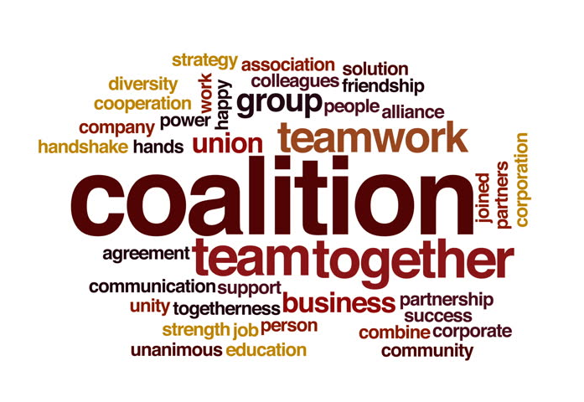
Building a Coalition
What is a coalition?
How does coalition building work in life experiences; getting support for a proposal at work, a community project; political issue or candidate?
Notes:
Have breakout groups report on their discussions.
Lead a discussion on Building a Coalition
What is a coalition? Why does it matter in making decisions regarding challenges faced by local Rotary clubs? How does coalition building work in life experiences, getting support for a proposal at work, a community project or political issue.
Building Coalitions is a big part of leadership. Developing these skills is key in effective leadership. Consider the issues faced in these scenarios. What comes first in planning projects? Who should be sought out in influencing members? What are the club’s real problems? Is this project “too big” for certain clubs? Who makes the decision that the project is too big?
NOTE: Rotary refers to these as “partners” but that is really confusing since Rotary uses the term partner for specific roles (Approved Partners – Matching Grants/Polio Plus Partners/ Spouses or Significant Others)

Slide 8

What about some people makes them INFLUENTIAL?
Notes:
Invite the group to consider the question on the screen.
In one or two words how you would describe an influential person? Add to the BLANK SLIDE.
Use Annotation Tools on blank slide to describe what makes a person INFLUENTIAL.

Slide 9
INFLUENTIAL PEOPLE
Notes:
Share responses as they are posted.
Lead a discussion about influential people – it might include:
Charisma
Titles
Hierarchy
Peers and Power
Doing the hard work
Plan to have power and influence

Slide 10
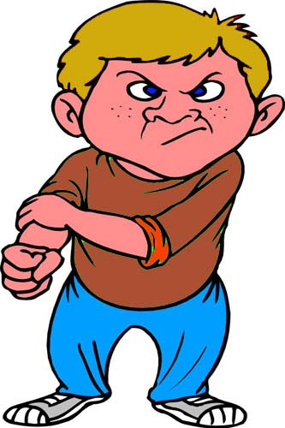
What Impedes Success?
Notes:
Ask the group the question: What leadership characteristics impede the success of a project?
Discussion might include:
Seeming elitist
Bullying
Pressing ahead without support
Failure to consult
Lack of respect for the project
Ignoring details of proposal

Slide 11
Notes:
Summarize the session by pointing out the Effective Leadership involves choosing the right tool for the job.
Stress the necessity of building coalitions to get things done.
Thorough analysis, listening and planning are key factors in successful leadership.
Conclude by reflecting on PROBLEMS & OPPORTUNITIES
Think about – In many Rotary clubs, problems are the flip side of opportunities. How can you bring fresh eyes to a problem that may help an innovative solution be revealed?
Some possibilities might include:
Bring new people into the process – different perspective; experiences; network
Bring in an expert seasoned Rotarian from another club who can help troubleshoot issues and solutions
Identify a trained facilitator to bring new perspectives to group
Research what other clubs or organizations are doing
Frame problem in a different way – look at bigger picture/illustrate it/frame it differently

