Slide 1


Attracting Members
RLI - Part 2
Notes:
Begin the session:
Introduce self
Describe format for the session
- Describe use of CHAT, Hand Raising, Breakouts, Polls,
Annotation Tools, and use of Webcam
NOTE: Contact Part 2 participants prior to the event and assign them Club Profile AM-2

Slide 2
Goals:
Identify
Identify my club’s Target Audience and Profile
Define
Define the Attributes of the Target Audience
Explore
Explore how my club can Attract the Target Audience
Reflect
Reflect on the changes in Rotary Membership and meeting guidance since 2016
Notes:
Review Session Goals, where this course fits into the Membership curriculum of RLI
Point out where to find referenced materials
Refer to Insert: AM-1 “Good to Know for Attracting Members”
Remind participants that they were assigned to complete the Club Profile AM-2. This will be used later in the session

Slide 3


“When a tree stops growing – it is ready to die…
…A Rotary club is like that: It is moving ahead only when it is growing. When the growing ends, the knife-and-fork club begins.”
1957-1958 RI President Charles G. Tennent – Little Lessons in Rotary (Third Edition), March 1978
Notes:
Share quote on screen and point our that this is from a past RI President regarding MEMBERSHIP and can be found in the participant manual.
In a word or phrase what comes to mind when you read the quote on the screen.
Do you agree/disagree? Why?
What is meant by knife-and-fork club?
Unmute or raise your VIRTUAL HAND and offer your thoughts
Take three or four examples*
*Limit the number of examples you take to control time spent

Slide 4

Attracting Members
What makes a club ATTRACTIVE?
How do we SELL IT to potential members?
Notes:
Present the questions on the screen.
Every Rotary club seeks new members to keep the club grow and thrive.
What makes a club attractive to folks in your community?
How do we then “sell” our club to potential members?
Take two or three examples.
Everyone in this session represents different clubs, districts and communities. We all bring the best of our clubs to the table along with the challenges we face. RLI is a place where we can share with other ROTARIANS the best of who we are and come away with possible solutions to our issues by sharing stories with each other.
Let’s begin with determining where we are.

Slide 5
POLL – What Describes Your Rotary Club?
We offer a warm Rotary welcome to our guests
Our programs are interesting and relevant.
Members eat at different tables each week
Our club collaborates with other clubs in grants and service projects
We raise funds so that members can contribute what they wish
Notes:
Set up the Poll by posing the question – What are the attributes of a growing, thriving club?
Attracting people to support Rotary is no different than attracting them to support a business. Attributes to which every club should aspire are included in this POLL. Which of these attributes does your club exhibit?
Launch the poll – give three (3) minutes for folks to respond
Share the results of the poll
Encourage participants to talk about why these attributes are ones to which all clubs should aspire
Ask for additional attributes that would be considered ‘best practices’
Share Attracting Members Handout (available in Documents for Class section of My Event)
Invite any additional thoughts regarding the attributes.

Slide 6

What Attracted You to Rotary?
Write a 3 to 4-word phrase about why you were attracted to join
Notes:
Ask the group:
What attracted you to Rotary? Share a 3 or 4-word phrase that reflects what attracted you.
Invite participants to raise their VIRTUAL Hand and unmute to respond to the question.
Take two or three examples.

Slide 7

Club Profile & Target Audience
What is unique about each club?
Who are the target members?
How can my club attract those members?
Notes:
Direct the group’s attention to the questions on the screen.
Look at your specific club…
What is unique about it?
Who are the target members?
How can your club attract these members?
Ask participants to look at the Club Profiles they completed in preparation for this session.
Everyone received Insert AM-2: Club Profile Sheet prior to this session and were asked to score your sheet. Put the total in the upper right corner of your sheet. What does that tell you about your club?
Give an opportunity for participants to respond. Invite them to unmute and/or raise their virtual hand to offer their thoughts.
Ask the group to note their club’s signature project(s) at the bottom of the page
Have them to write three (3) positive adjectives that describe their club

Slide 8

BREAKOUT Create a Club
Name your club
For what signature project(s) or event(s) is your club known in the community
Describe your club – 3 positive adjectives
Why join this club?
Who should join this club?
How will you attract these folks?
Notes:
Divide participants into groups of 4-5 people
Provide them with directions on their task for the breakouts
Direct participants to the document “Breakout 1 Directions” in Documents for Class in My Event.
Review the task and address questions regarding what they are to do
Direct participants to choose a spokesperson that will report back to the whole group
We will now divide into BREAKOUT GROUPS.
Reconvene the whole group
Have each group share the results of their breakout
Encourage feedback from other groups

Slide 9

If it’s broken…
Addressing Issues Facing Local Clubs
Loss of members
New members stay for <1 year
Lack of enthusiasm
No support of TRF
Notes:
After looking at what attractive clubs look like introduce this activity as an exercise that will address fixing broken clubs.
Talk about what issues local clubs face.
Give instructions about how this round of breakouts will be organized.
Form Breakout groups with 3-5 people each (could be same groups or re-shuffled to interact with different people.
Assign each breakout group a scenario (A – F). Make sure the breakout scenarios are available in Documents for Class in My Events.
Refer to the “Breakout 2 Directions” in Documents for Class in My Events.
Using the attributes of growing, thriving clubs previously discussed we will now talk about how to rescue a dying club. In breakouts you will have a real-life situation that often occurs in Rotary. With your Breakout Buddies share the challenges your experience in creating an ATTRACTIVE Rotary club. Together look at the assigned scenario. Develop an action plan to address the issue. Choose a spokesperson who will share your plan to the whole group.
Launch breakouts
Reconvene whole group and hear the small group scenarios and solutions

Slide 10
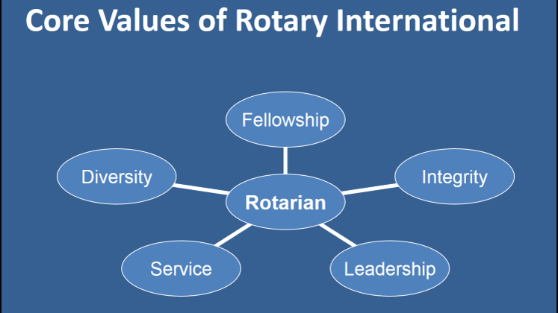
Notes:
Talk about Membership Efforts by presenting relevant, practical information about fixing and selling your club so that it will grow and flourish.
Once changes are implemented that are designed to increase the attractiveness of a Rotary club. It is time to sell the benefits of Rotary membership.
Turn to the page 2 of the Attracting Membership Handout previously shared. In particular the bullet points that encourage embracing Rotary’s Core Values.
Let’s hear your thoughts about Attracting Members
Encourage feedback and open discussion. Refer the group to the Insert AM-1 “Good to Know for Attracting Members” page 43, Participant Manual

Slide 11

Changes…
Where to meet?
How often?
What is a meeting?
Passport clubs
Eclubs
Rotoracters are Rotarians
Notes:
Continue the discussion by reporting on the recent changes to membership guidelines.
Point out the changes accepted by the Council on Legislation in 2016
Rotary clubs are different from each other because of different make up of people, communities, ages and missions
Talk about the new more flexible rules for Rotary clubs that allow more diversity and different features, so variations are increasing in what clubs look like
Many different forms of clubs are now emerging across the US and around the world
Refer participants to resources available on: https://my.rotary.org/en/club-flexibility

Slide 12

Membership Committee
https://www.rotary.org/en/about-rotary/membership
Notes:
Invite participants to explore creating a Membership Committee in their club
Refer to Insert AM-4: Club Membership Committee, page 45 Participant Manual
Point out that Rotary has many resources and ideas to help clubs grow membership.
https://www.rotary.org/en/about-rotary/membership
801_membership_assessment_tools_en.pdf (www.rotary.org )
417_strengthening_your_membership_en.pdf (www.rotary.org )

Slide 13
Reflection – Final Thoughts
What are three things you will take back to your club on Attracting Members?
Notes:
Conclude with the challenge to follow-up with home club:
Let’s RAPID SHARE – Name three things that you will take back to your club on how to attract new members.”

